Slide 1
CryoGAN: A New Reconstruction Paradigm for Single-particle Cryo-EM Via Deep Adversarial Learning
STUDENTS: Dmitry rudMAN, ARSENY BELOUSOV
Harshit Gupta, Michael T. McCann, Laurene Donati, Michael Unser Biomedical Imaging Group, EPFL, Switzerland

Slide 2
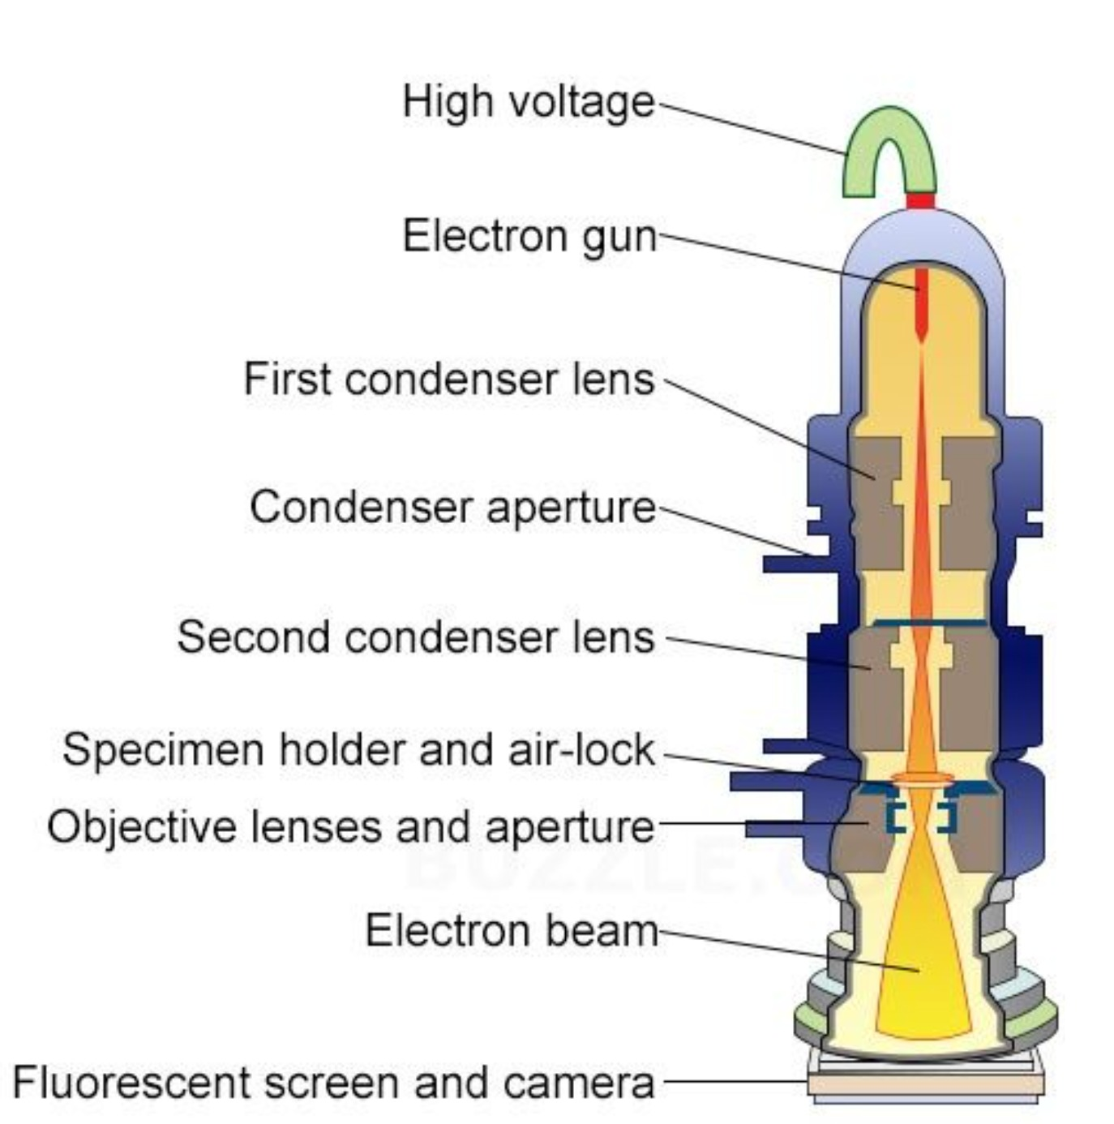
Transmission Electron Microscope
(Direct detection camera)
Notes:
How is the image generated and how does the microscope actually functions internally.
To create an electron beam a V-shaped thin tungsten wire is used, so called “Thermionic cathode”, heated up by electric current it emits electrons into the vacuum. Below the cathode a metallic disk with a central borehole is installed, the anode. The anode is connected with a positive pole of a high voltage source, the thermionic cathode with a negative pole. The strong electric field between cathode and anode accelerates the electrons downwards.
Electromagnetic lens system
After leaving the electron source, the electron beam is tightly focused using electromagnetic lens and metal apertures. The system only allows electrons within a small energy range to pass through, so the electrons in the electron beam will have a well-defined energy.
Sample holder
The sample holder is a platform equipped with a mechanical arm for holding the specimen and controlling its position.
Imaging system
The imaging system consists of another electromagnetic lens system and a screen. The electromagnetic lens system contains two lens systems, one for refocusing the electrons after they pass through the specimen, and the other for enlarging the image and projecting it onto the screen. The screen has a phosphorescent plate which glows when being hit by electrons.
Working principle
TEM works like a slide projector. A projector shines a beam of light which transmits through the slide. The patterns painted on the slide only allow certain parts of the light beam to pass through. Thus the transmitted beam replicates the patterns on the slide, forming an enlarged image of the slide when falling on the screen.

Slide 3
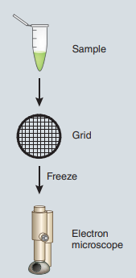
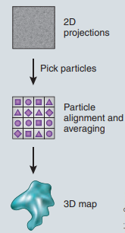
The overall single-particle cryo-EM workflow, from protein sample to 3D map
Reconstruction
by CryoGAN
Notes:
Cryo-EM was selected by Nature Methods as Method of the Year 2015, and the Nobel Prize in Chemistry 2017 was awarded to Jacques Dubochet, Joachim Frank and Richard Henderson.
In transmission electron microscopy (TEM), accelerated electrons pass through and interact with the specimen. The interference between scattered and non-scattered electrons results in the so-called phase contrast and image formation. Because electron microscopes require high vacuum, living cannot be examined by this method at room temperature.
A cryo-EM experiment begins with a purified protein sample. The protein solution is applied to a special sample grid consisting of tiny holes. Ideally the protein particles distribute evenly within the grid holes in a variety of orientations. The grid is then plunged into a cryogen such as liquid ethane, flash-freezing it (77 K), and trapping the particles in a thin film of vitreous ice. In addition to capturing the protein structure at the moment of freezing, this process protects the sample to some degree from radiation damage and prevents evaporation of buffer in the high-vacuum conditions of a transmission electron microscope.
From 2D images to 3D model
The name ‘single-particle’ cryo-EM comes from the fact that 2D electron micrographs are snapped of individual protein particles on the sample grid. Because very low electron doses must be used in order to avoid damaging radiation- sensitive samples, such 2D projections are too noisy to allow structures to be resolved in atomic detail.
Particles are often frozen in random orientations on the sample grid, so averaging is not a straightforward process. This is beneficial, however, because many different 2D views of a protein are needed to reconstruct its 3D structure. Sophisticated image-processing methods are used to align the images and merge the data.
Next, an initial 3D map is constructed. This map is iteratively refined and validated using dedicated software tools
The reconstruction procedure in single-particle cryo-EM is complex. High-dimensional nonconvex optimization problem with numerous local minima, the outcome usually depends on the quality of the initial reconstruction (alignment and averaging). It often relies on the input of an expert user for appropriate processing decisions and parameters of the system. A key reason behind such complexity is that the measured particles have unknown poses. To handle this, current methods either estimate the poses or marginalize them in likelihood-based optimization procedures. Both are computationally challenging approaches that can demand large resources or rely on approximations.
To overcome these limitations, we introduce CryoGAN, an unsupervised reconstruction algorithm for single-particle cryo-EM that exploits the remarkable ability of generative adversarial networks (GANs) to capture data distributions

Slide 4
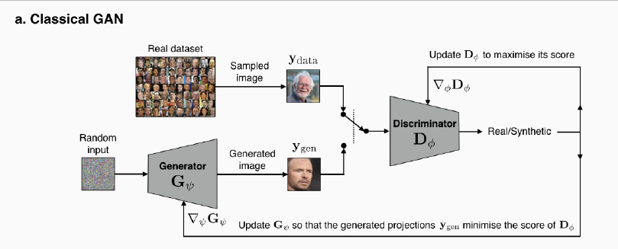
GAN – generative adversarial network
Notes:
The main concept that we must understand is the GAN.
In a classical GAN, the two entities are convolutional neural networks (CNNs) - respectively known as the generator and the discriminator - that are trained simultaneously using backpropagation.
The main idea of ​​GAN is based on "indirect" learning through a discriminator, which is also dynamically updated. This basically means that the generator is not trained to minimize the distance to a specific image, but rather is fooling the discriminator.
(((You can compare this model with the following situation: a group of criminals wants to introduce their person to work in Elbit, but each interview takes place with an inspector using a lie detector. Each time the inspector learns new tricks from potential criminals, just as criminals learn how it will be more effective to deceive the inspector. Thus, we can interpret how the two main modules work and interact with each other - the discriminator and the generator.)))

Slide 5
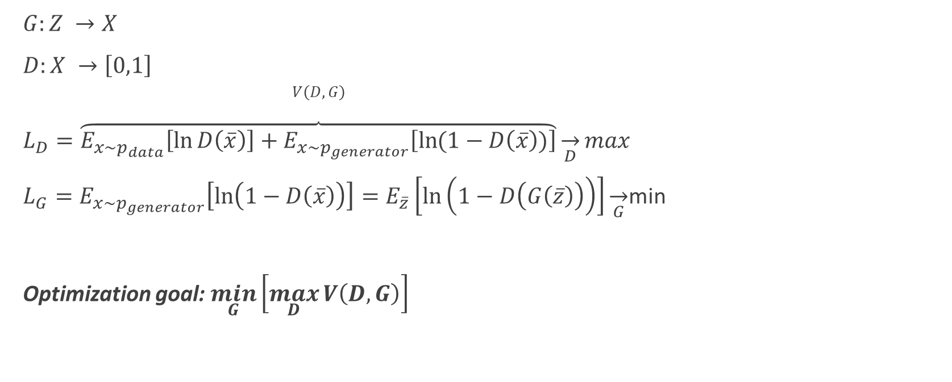
Cross-Entropy Loss of GAN
$G:Z →X$
$D:X →\left[0,1\right]$
$V\left(D,G\right)$
$L_{D}=\overbrace{E_{x\sim p_{data}}\left[\ln{D\left(\overline{x}\right)}\right]+E_{x\sim p_{generator}}\left[\ln{(1−D\left(\overline{x}\right))}\right]}\overset{→}{D}max$
$L_{G}=E_{x\sim p_{generator}}\left[\ln\left(1−D\left(\overline{x}\right)\right)\right]=E_{\overline{z}}\left[\ln\left(1−D\left(G\left(\overline{z}\right)\right)\right)\right]\overset{→}{G}$min
Optimization goal: $\min_{G}\left[\max_{D}{V\left(D,G\right)}\right]$
Notes:
Z is the space of random noise.
X – it is pixels, translated into the probability that the photo is real.
For better understanding, we will define the range of values for the discriminator in the range from 0 to 1, false and true, respectively. We see that the discriminator error (LD) function solves the binary classification. Its error function will be the cross-entropy between correct answers (zeros and ones) and what it produces D (x). Accordingly, we want the discriminator to give the maximum value (close to 1) for the real data and the minimum for the data received from the generator. This is what the discriminator wants.
The generator, in turn, wants to deceive the discriminator by taking the same function and minimizing it. But as far as the generator can influence only one of the values (correspondingly, the second in the discriminator equation), then it wants to minimize only it.
This is how we get the final optimization problem (minimizing the loss of the generator together with maximization the loss of the discriminator)

Slide 6
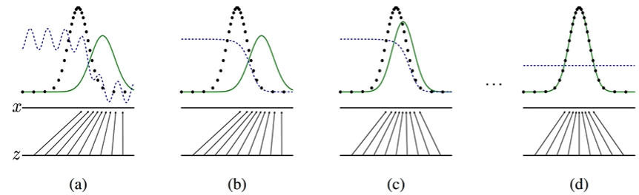
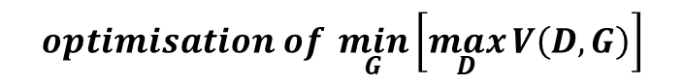
1D example
$$optimisation of \min_{G}\left[\max_{D}{V\left(D,G\right)}\right]$$
Notes:
(Ролик, 38 минута)
Training process is similar to Expectation-Maximization algorithm and occurs alternately:
1. Fix the generator and update the discriminator with the error function;
2. Fix the discriminator and update the generator with its error function.
You can see a demonstration of this process.
Z is the random noise of uniform distribution.
Black dots represent the real data.
Green line it is the product of generator. (In this example these are parameters of Gaussian).
Dotted blue line represents classification by the discriminator.
At the beginning discriminator describes by random line and generator produces meaningless random noise. We begin learning process by fixing the generator and training the Discriminator which transform into the Sigmoidal line. When the line in proximity to “one”, Discriminator classifies input data as real and when the line goes down to “zero” – the input data classified as false. Next, we fix Discriminator (fig b) and begin to train Generator (fig c) to confuse Discriminator. In that way we encourage Discriminator to get better when Generator is fixed. And so on and so forth.
In multidimensional problems to estimate the similarity between real and simulated distributions we use more advanced algorithms to optimize cross-entropy loss such as Wasserstein loss which is used in CryoGAN.

Slide 7
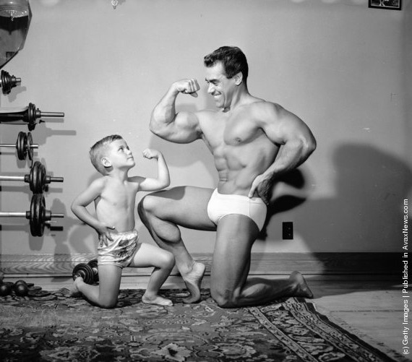
Generator and Discriminator
Discriminator
Generator
https://avax.news/touching/Bodybuilders.html
Notes:
Generally speaking, we prefer our Generator to be one step behind from the Discriminator to keep improving the generated data, in other way we would get visually wrong pictures from generator that will be defined as “true” by Discriminator.

Slide 8
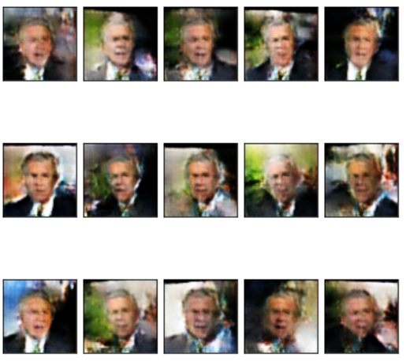
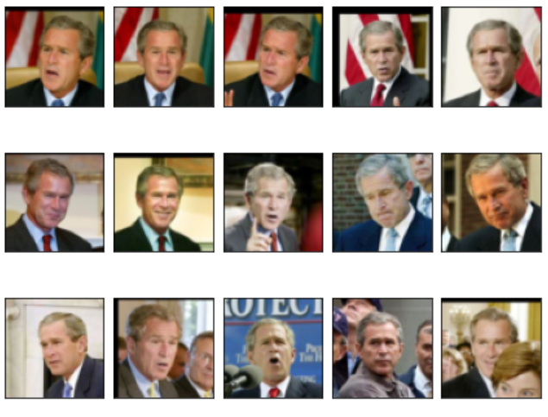
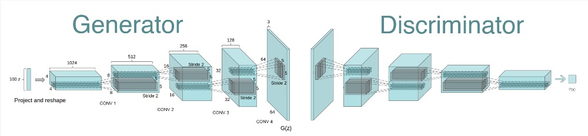
Training with POTUS
Notes:
With the help of the PyTorch library, we implemented classical GAN, processed a number of photographs (about 500) of George W. Bush, and got something like this (a set of the best). As we can see, some of images look similar.

Slide 9
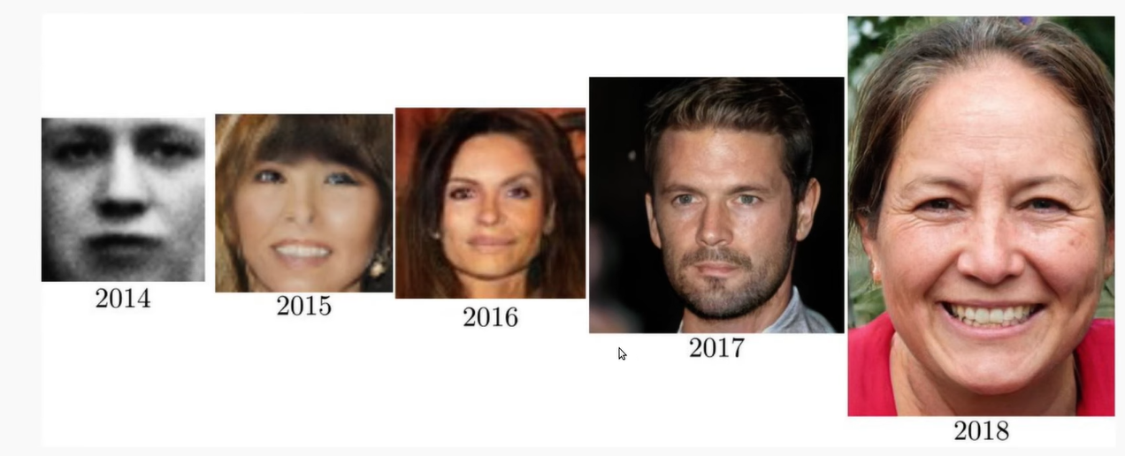
Evolution of GAN

Slide 10
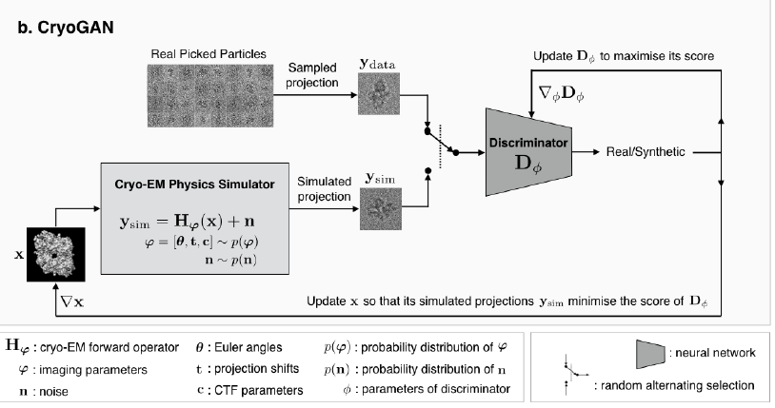
CryoGAN
Notes:
Similar to GANs, CryoGAN is driven by the competitive training of two entities: one that captures the real data distribution, and another that discriminates between generated samples and samples from the real dataset.
The important twist with CryoGAN is that we replace the generator network by a cryo-EM physics simulator.
Physics simulator
The two-dimensional images collected from an electron microscope are not perfect 2D projections of the three-dimensional structure. Each experimentally collected image can be treated as a modulated projection with noise. The modulation of the image is determined by a number of factors that are related to the electron microscope settings and imaging conditions. The modulation process has been modelled mathematically as the contrast transfer function (CTF). Each of these functions contains a number of parameters affecting the image contrast and quality. The Cryo-EM Physics simulator represented by these parameters.
By replacing the generator network by a cryo-EM physics simulator, CryoGAN learns the 3D density map whose simulated projections are the most consistent with a given 2D measurement set in a distributional sense.
No estimation of the poses is attempted during the learning procedure; rather, the reconstruction is obtained through distributional matching
CryoGAN requires no prior knowledge of the 3D structure; its learning process is purely unsupervised. The user needs only to feed the picked particles and CTF estimations to the algorithm. No initial estimate of the volume is needed: the algorithm starts with a volume initialized with zeros.
CryoGAN exploits this ability to look for the volume whose simulated measurements have a distribution that matches this real data distribution. This is achieved by adding a “cryo-EM physics simulator” that produces synthetic measurements following a mathematical model of the cryo-EM imaging procedure.

Slide 11
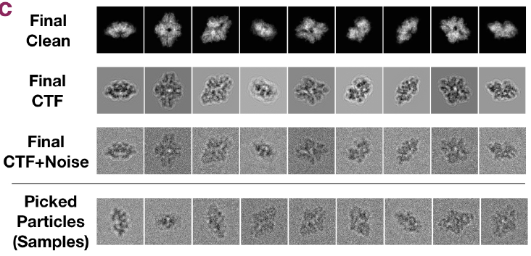
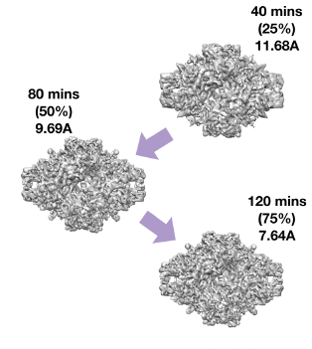
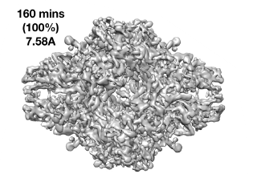
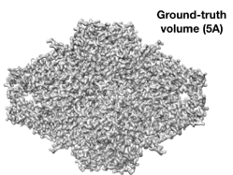

Performance on a Synthetic Dataset
Notes:
Synthetic data
First, the performance and stability of CryoGAN on a synthetic β-galactosidase dataset was assessed, we generated noisy projections from a 5A β-galactosidase volume.
Starting with zero-values, the volume is progressively updated to produce projections whose distribution matches that of the picked particles. These gradual updates are at the core of the deep adversarial learning scheme of CryoGAN. At each algorithm iteration, the gradients from the discriminator carry information about the current difference between the picked particles (“real data”) and the generated projections (“fake data”). Those gradients are used by the cryo-EM physics simulator to update itself and learn a volume that yields more realistic projections. Hence, at the end of its run, the volume learned by CryoGAN has projections that are similar to the picked particles in a distributional sense.
The results demonstrate that our unsupervised reconstruction paradigm permits accurate recovery of a high-resolution 3D structure.

Slide 12
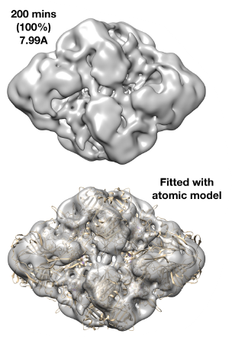
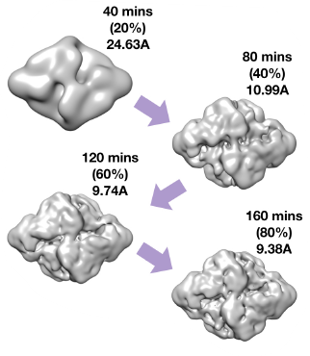
Results on Real Data
Notes:
Real data
41,123 β-galactosidase particles were taken to examine the CryoGAN performance. The dataset obviously represents a much more challenging test-case for CryoGAN, whose adversarial learning scheme relies on our ability to faithfully model the imaging physics of cryo-EM.
We ran CryoGAN for 160 minutes to obtain a 3D reconstruction wit 7.99A resolution. CryoGAN progressively converges toward the reconstruction that best explains the statistics of the dataset. For this particular run, this resulted in a 7.99A β-galactosidase structure whose synthetic projections closely resemble the real picked particles, both visually and—more importantly—statistically.
Finally, the protein sequence is fitted into the 3D map to build a 3D model of the protein.

Slide 13
Bibliography
Gupta, H., McCann, M. T., Donati, L., & Unser, M. (2020). CryoGAN: A new reconstruction paradigm for single-particle cryo-EM via deep adversarial learning. In bioRxiv. https://doi.org/10.1101/2020.03.20.001016
Doerr, A. (2015). Single-particle cryo-electron microscopy. In Nature Methods. https://doi.org/10.1038/nmeth.3700
Quentin, D., & Raunser, S. (2018). Electron cryomicroscopy as a powerful tool in biomedical research. In Journal of Molecular Medicine. https://doi.org/10.1007/s00109-018-1640-y
Yang, C., Jiang, W., Chen, D. H., Adiga, U., Ng, E. G., & Chiu, W. (2009). Estimating contrast transfer function and associated parameters by constrained non-linear optimization. Journal of Microscopy. https://doi.org/10.1111/j.1365-2818.2009.03137.x
Bendory, T., Bartesaghi, A., & Singer, A. (2020). Single-Particle Cryo-Electron Microscopy: Mathematical Theory, Computational Challenges, and Opportunities. IEEE Signal Processing Magazine. https://doi.org/10.1109/MSP.2019.2957822

Slide 14

That’s all, Folks!

